Slide 1
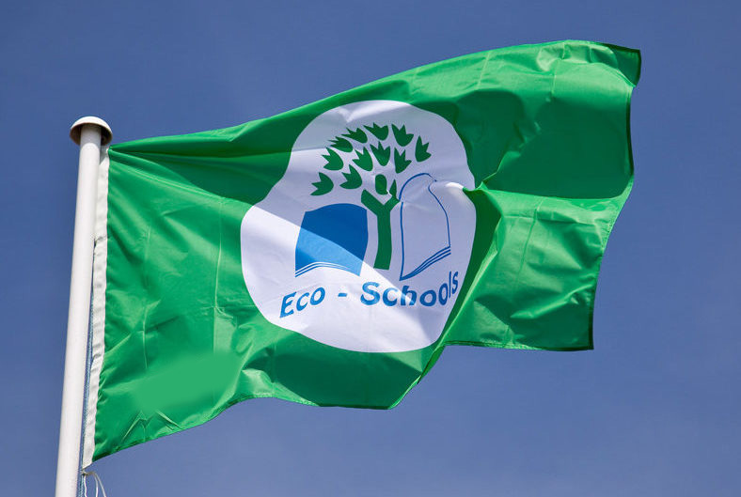
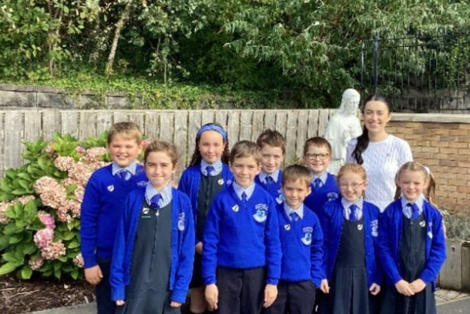

Slide 2
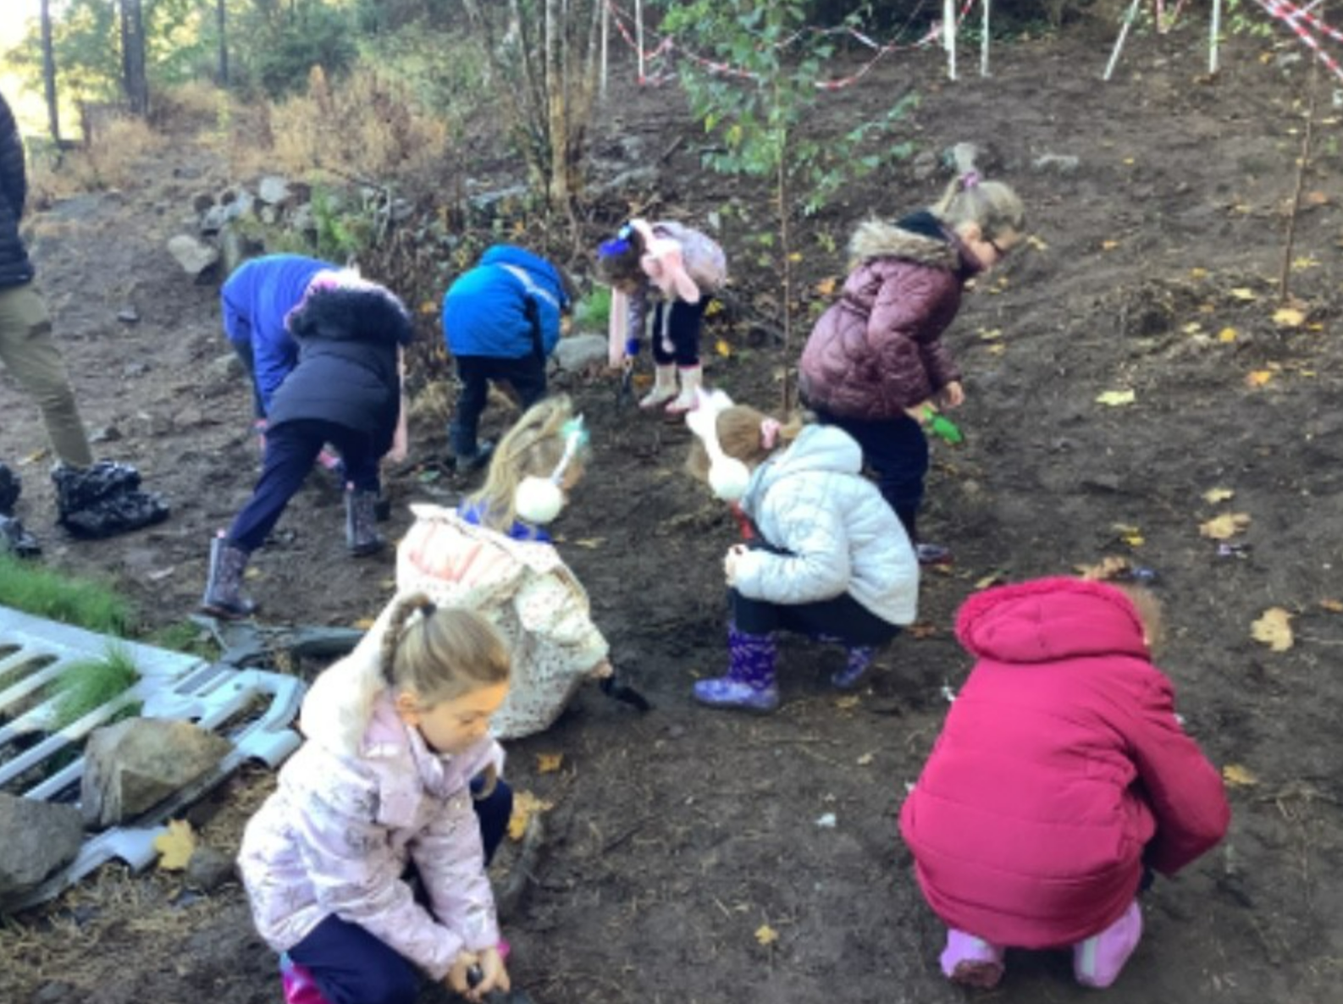
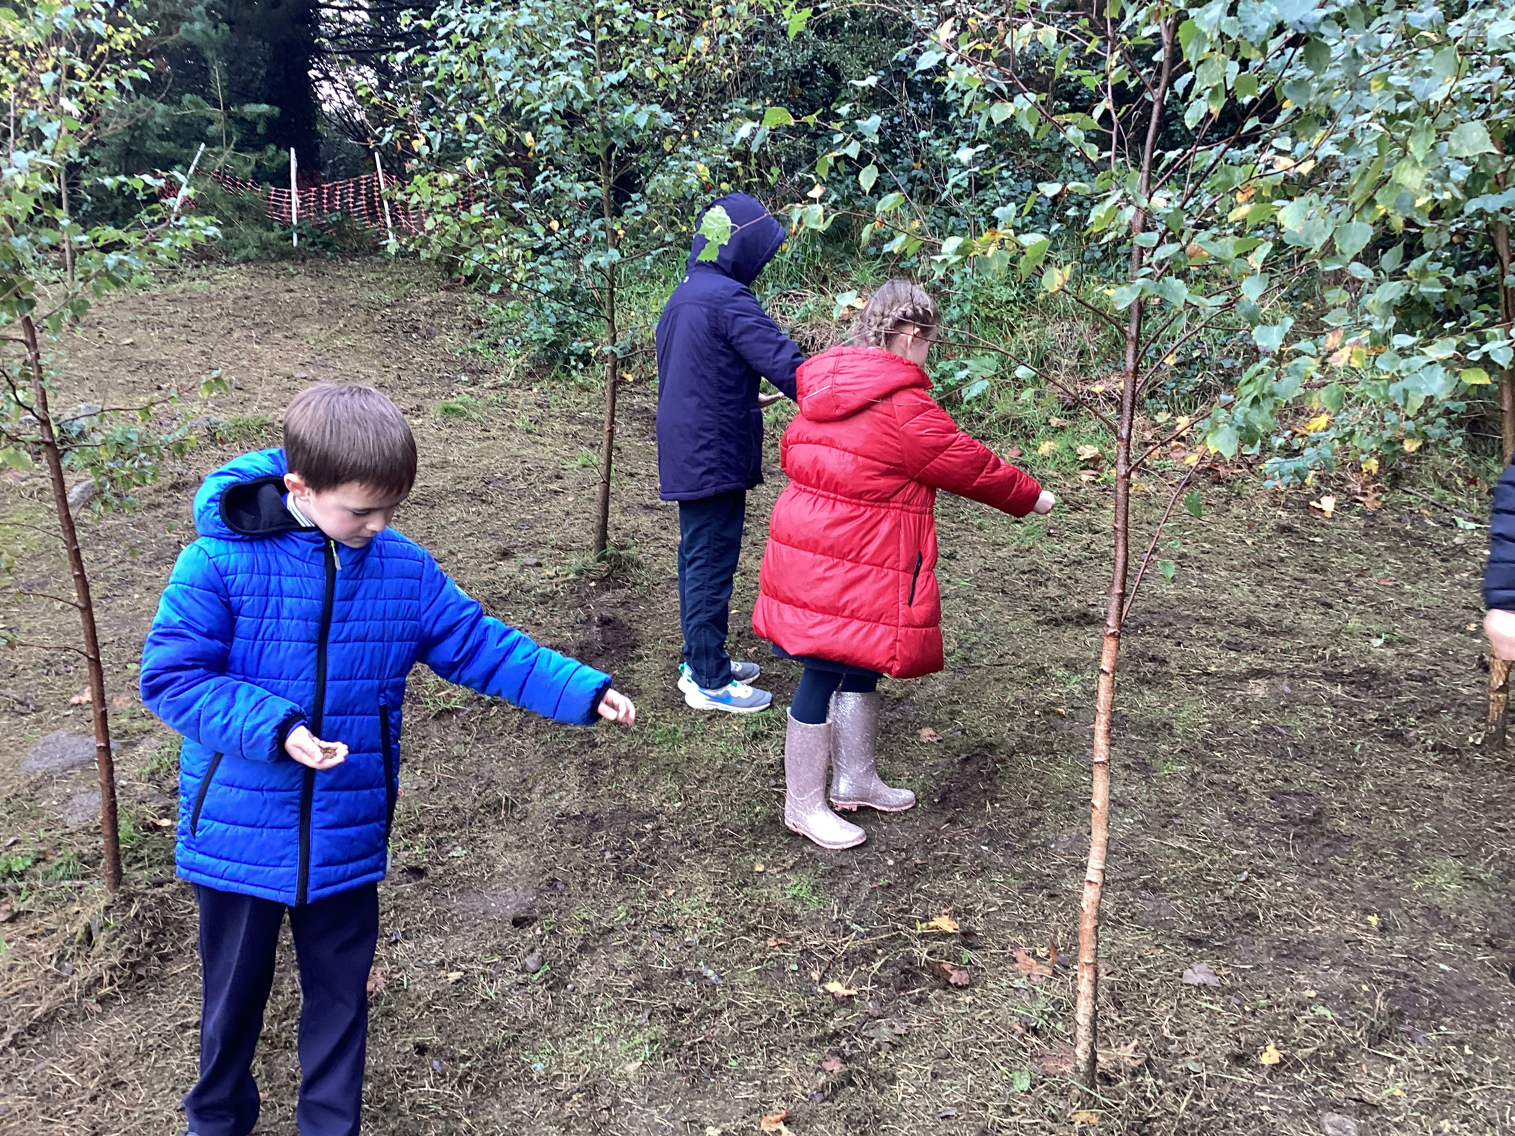
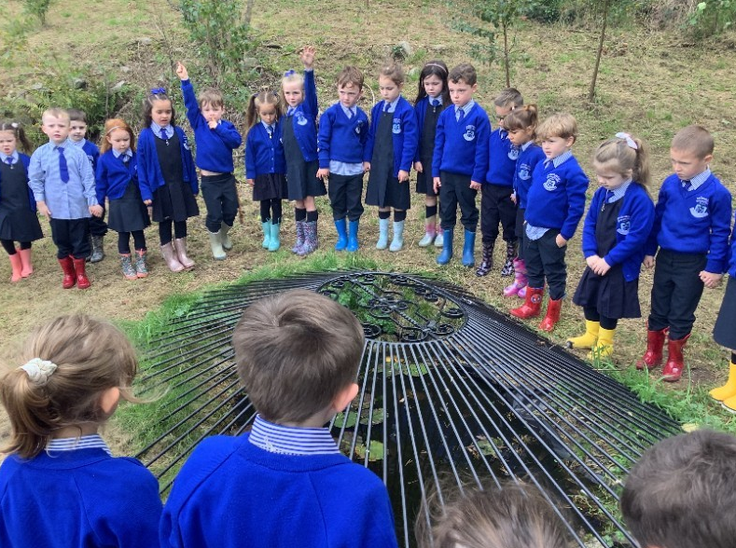
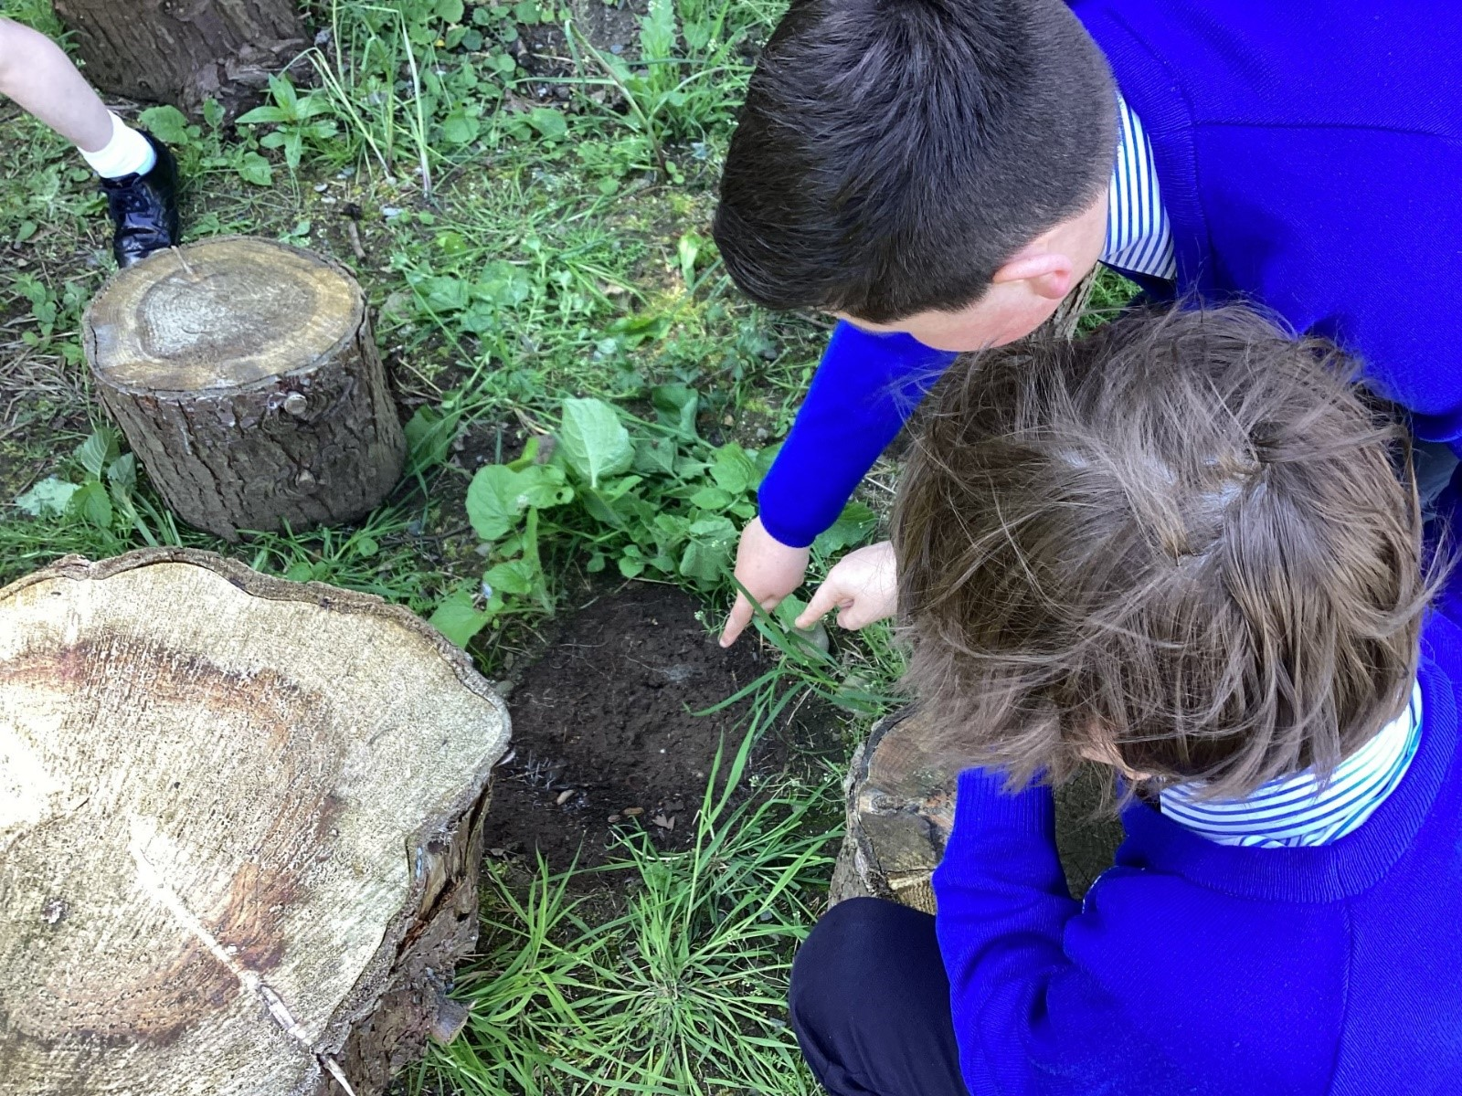
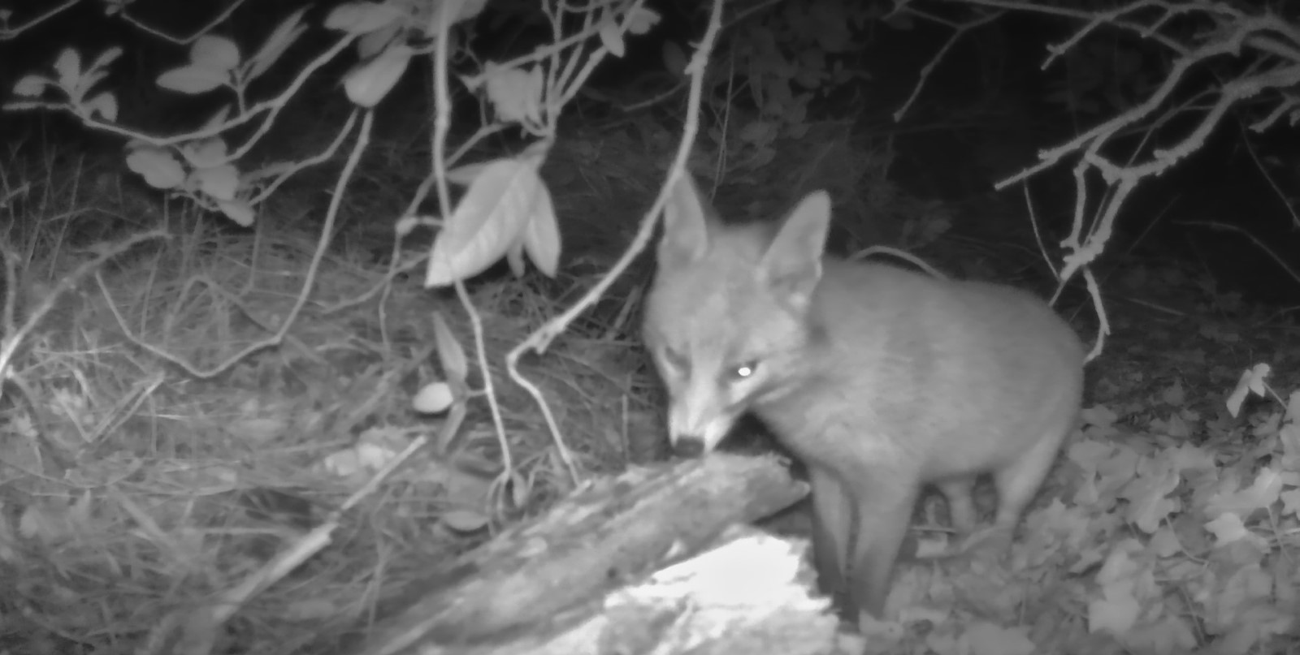
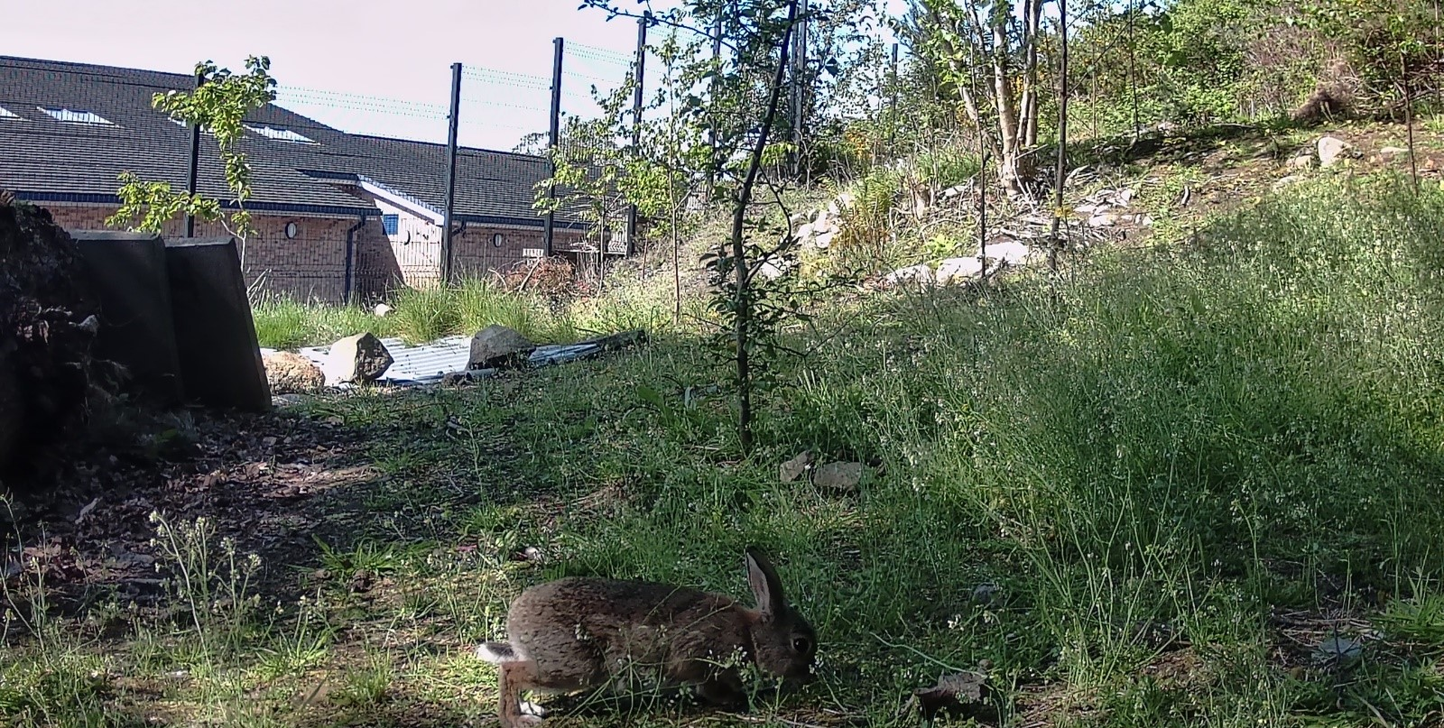
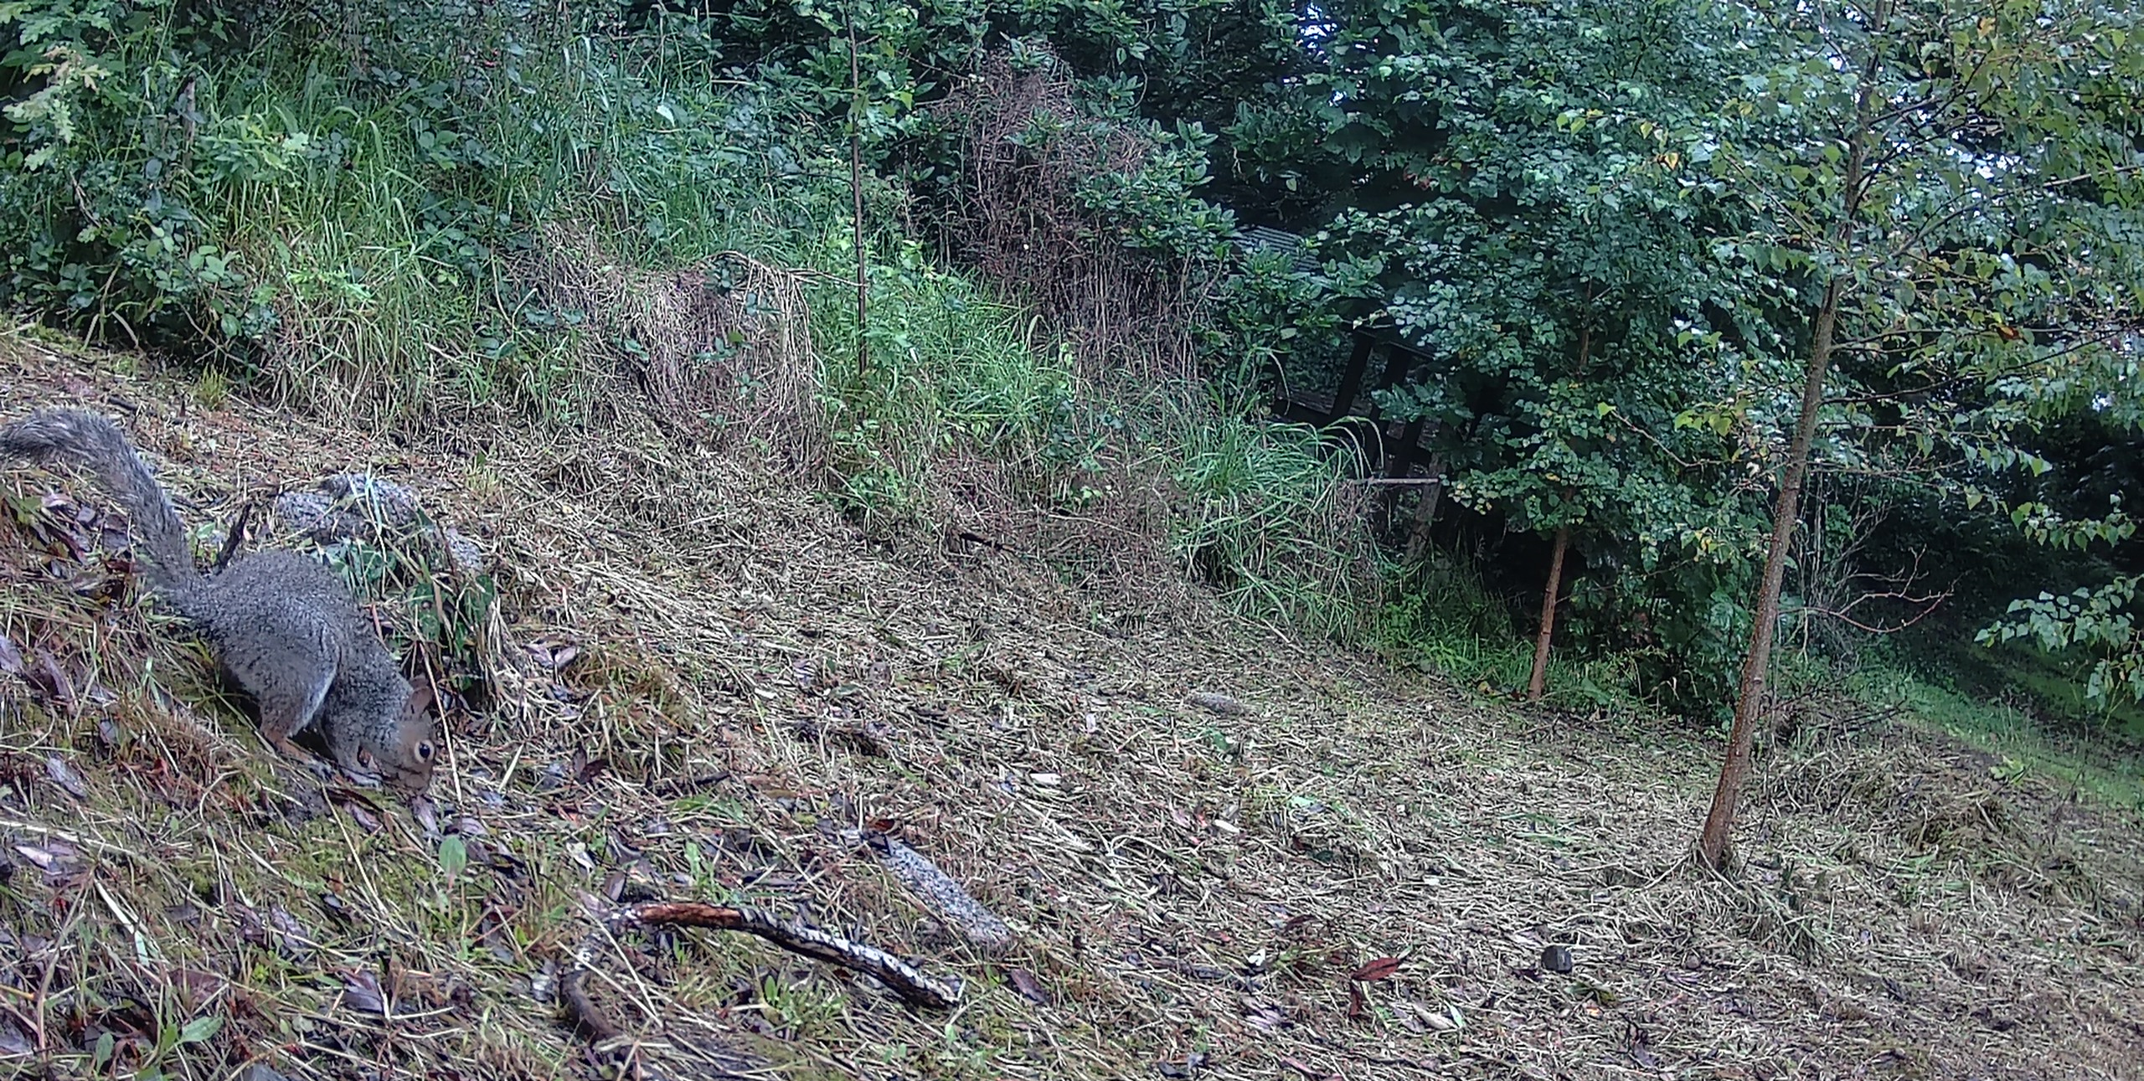
St. Francis’ Garden
Each class planted bulbs and each teacher planted a native tree.
We planted yellow rattle seeds.
The pond was dug out in 2022 and developed throughout the 22-23 and 23-24 school year.
We enjoy looking for minibeasts and bugs.
The wildlife cameras show us the animals that visit our garden. These videos and photos are shared on the website. We have been working on developing St. Francis’ Garden for a number of years.

Slide 3
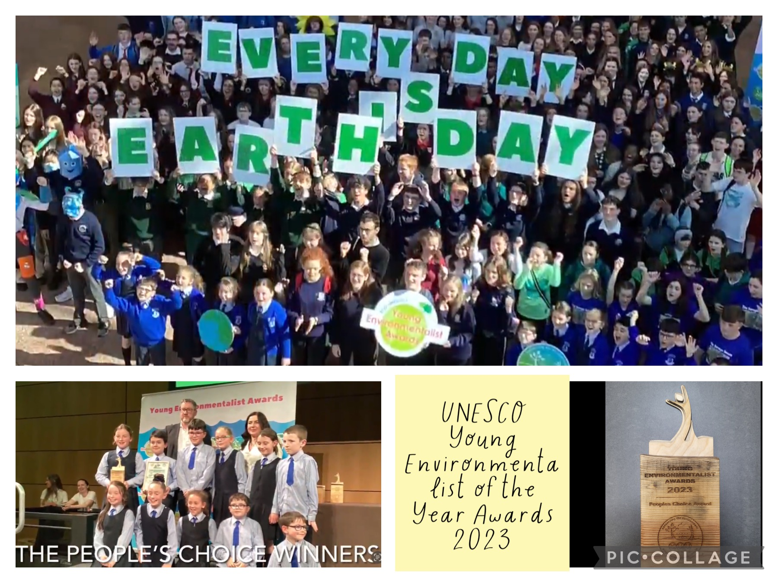
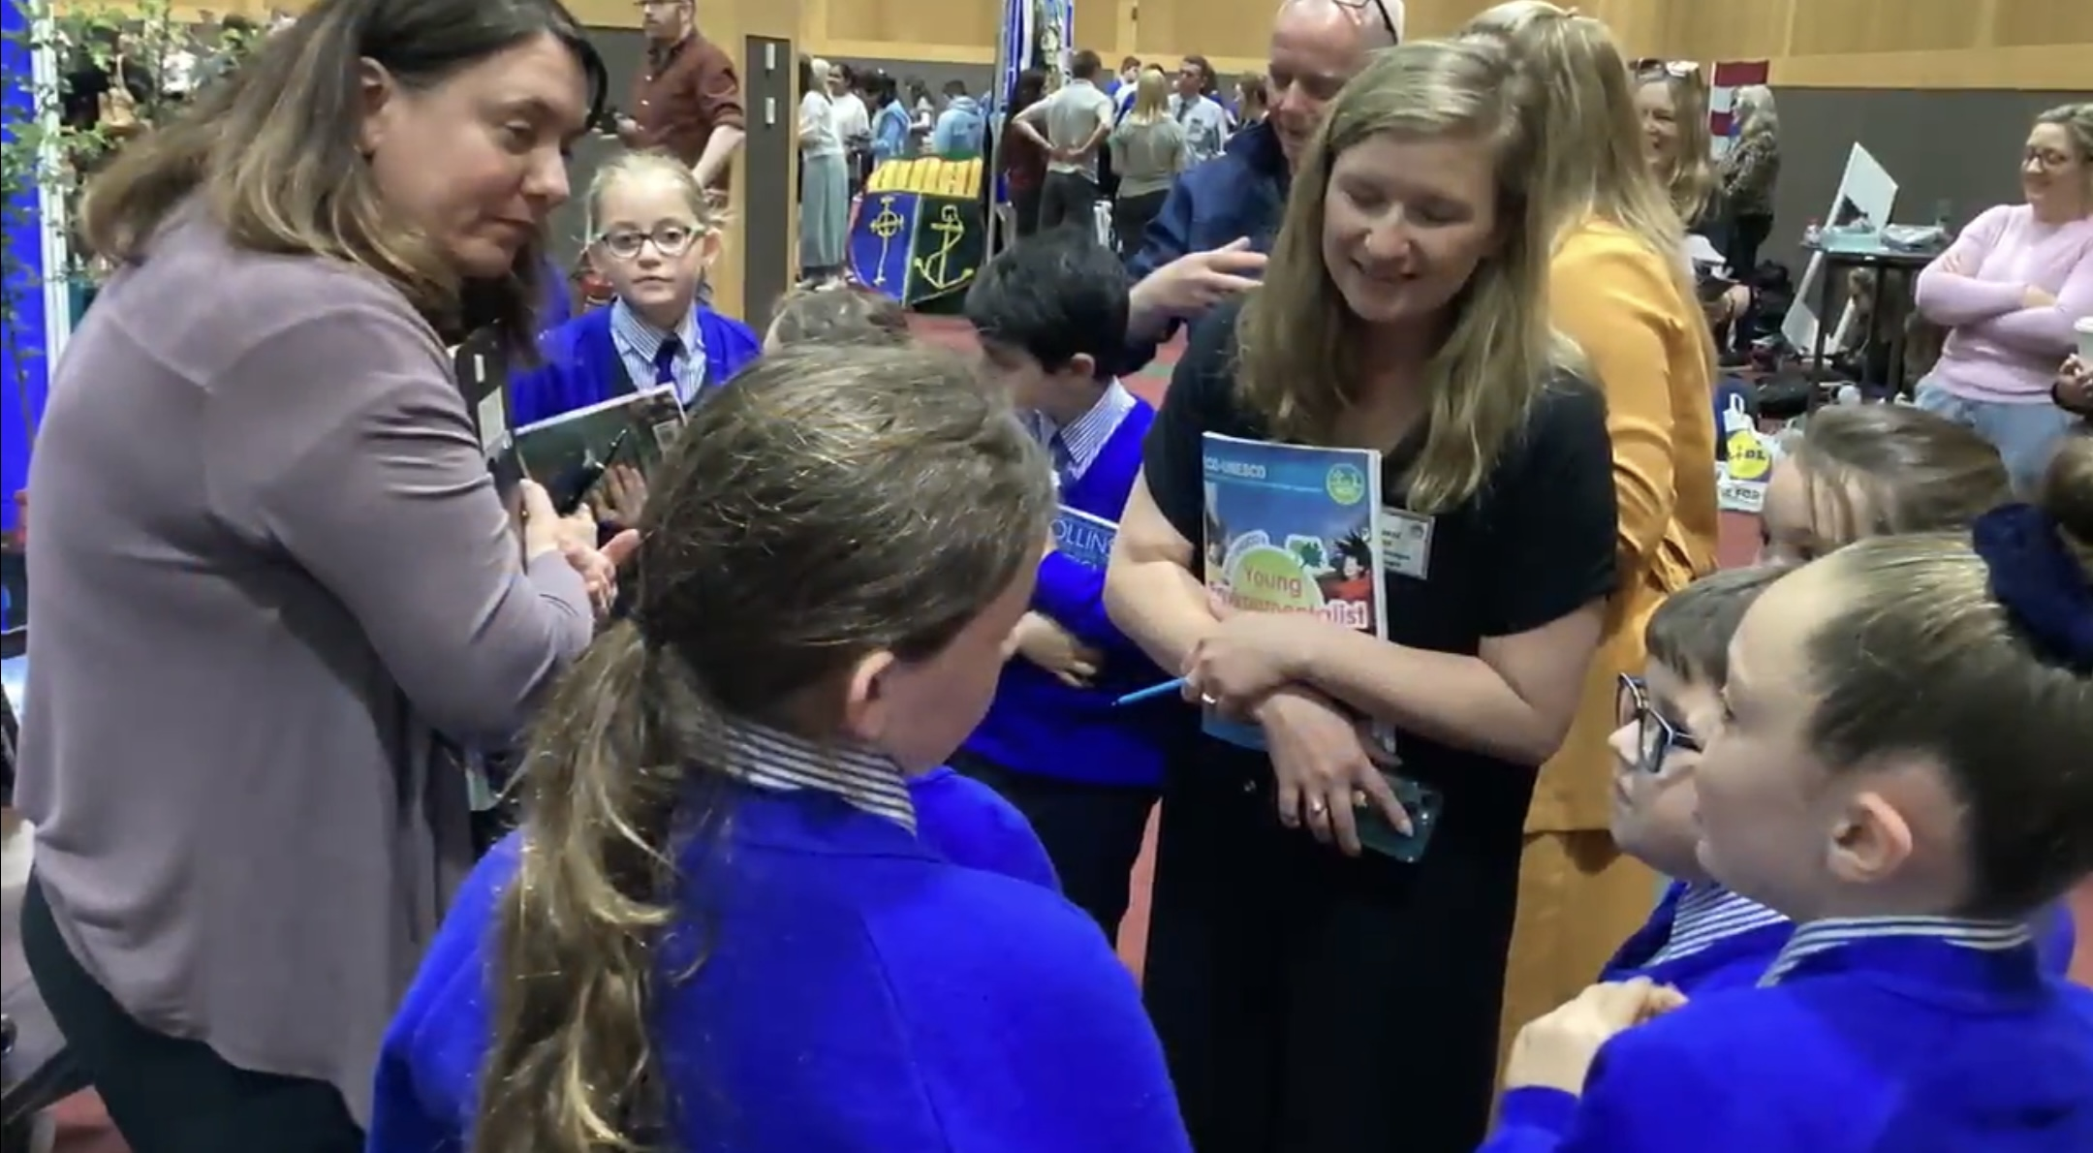
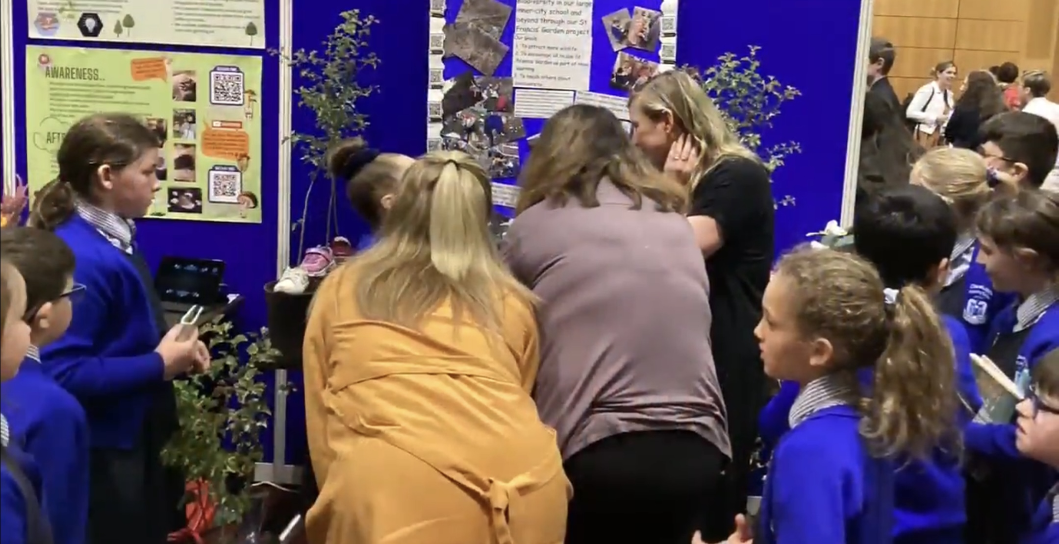
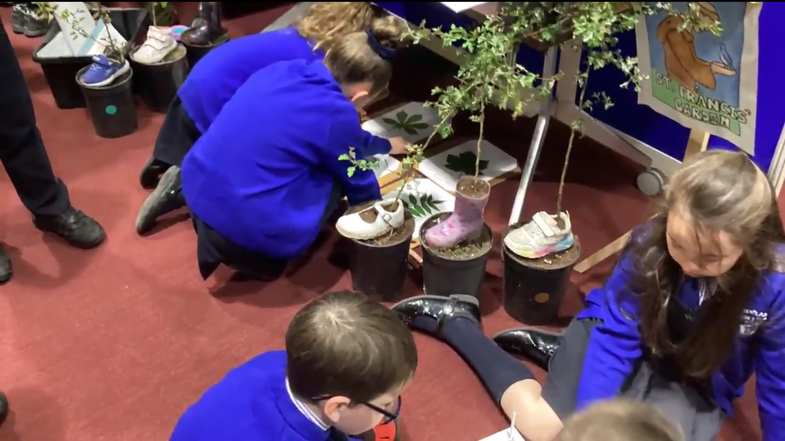
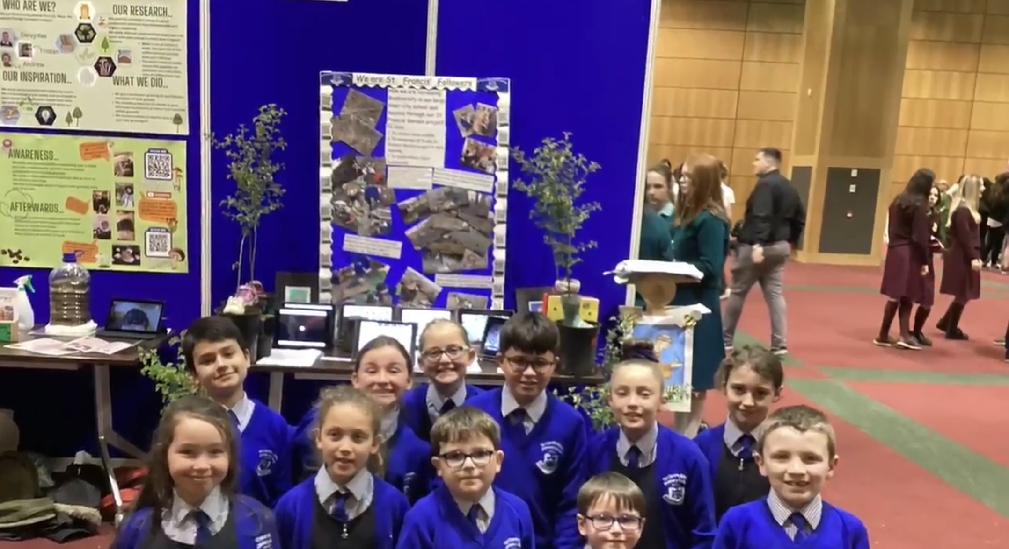
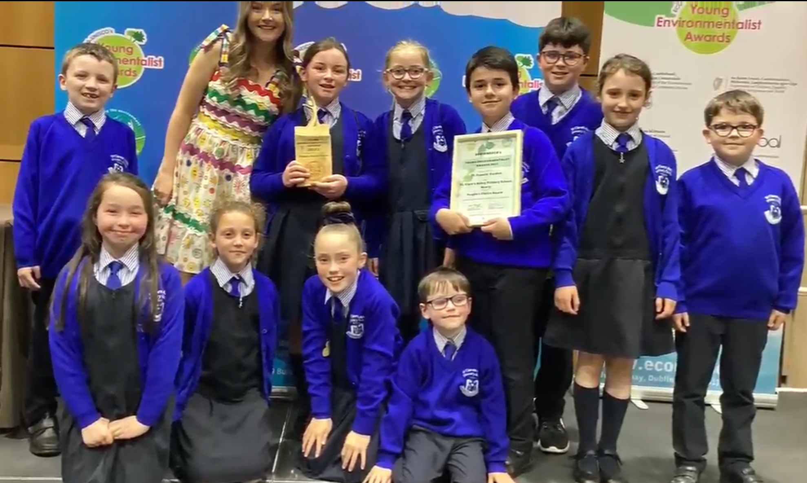
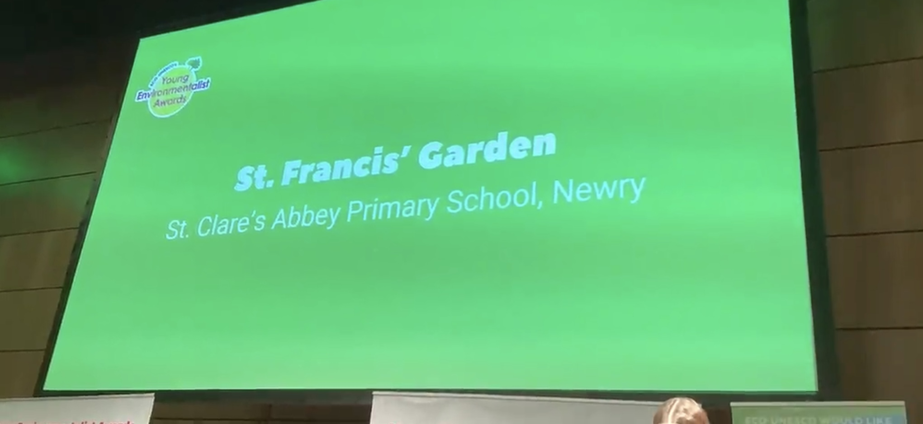
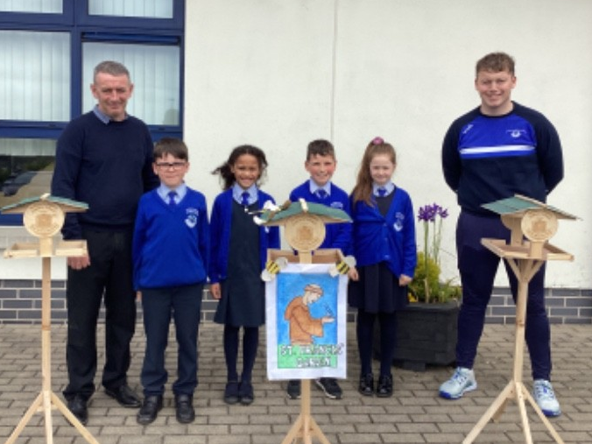
UNESCO Young Environmentalist of the Year Award in Dublin – People’s Choice Winners
We entered the UNESCO Young Environmentalist of the Year awards in 2020 and 2023. We won the People’s Choice award in 2023 for our work in St. Francis’ Garden.

Slide 4
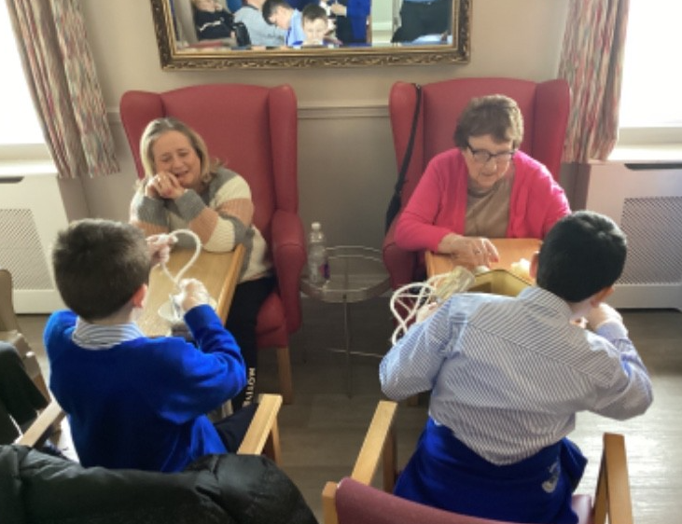
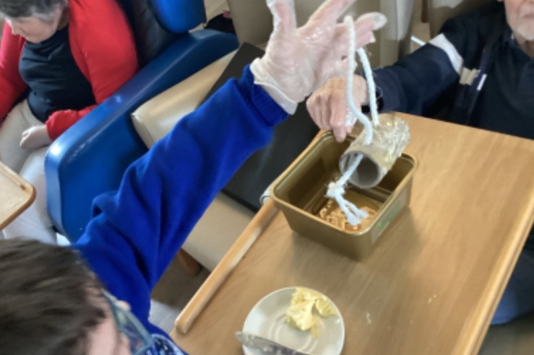
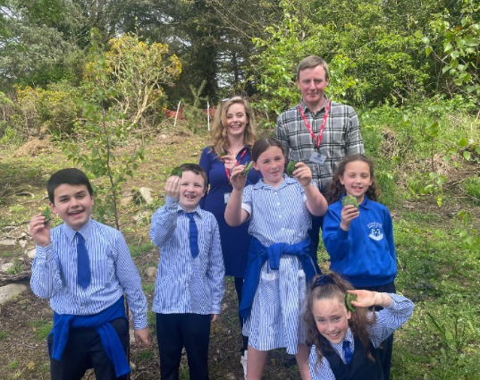
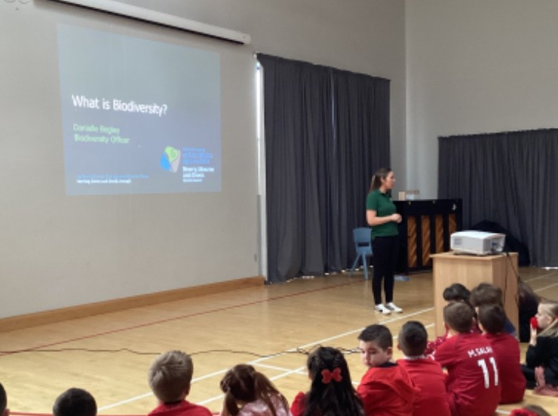
Wider Community
We work with the wider community to share our Eco-work.
We visited Rockfield Nursing home and made bird feeders.
Justin McNulty, a local councillor, MLA, came to visit our school and we told him all about our work on Biodiversity.
We had an assembly from a Biodiversity officer who told us about pollen.

Slide 5
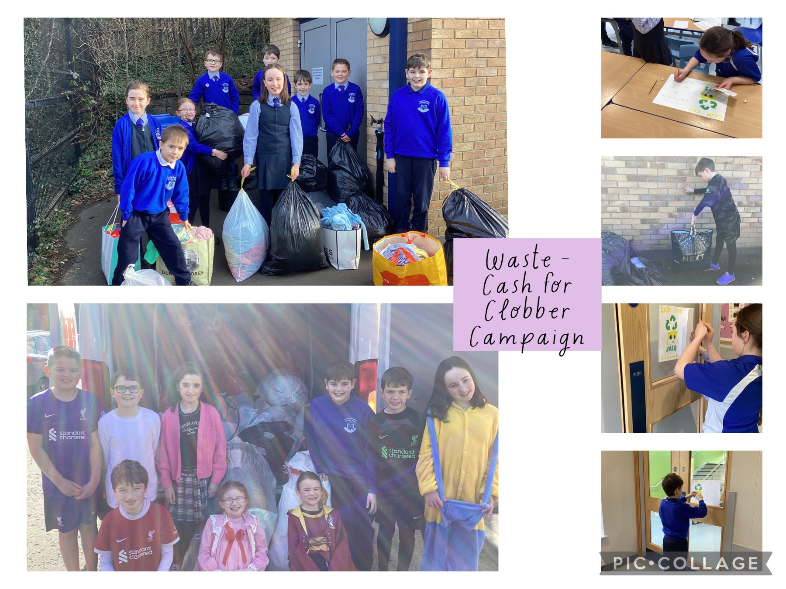
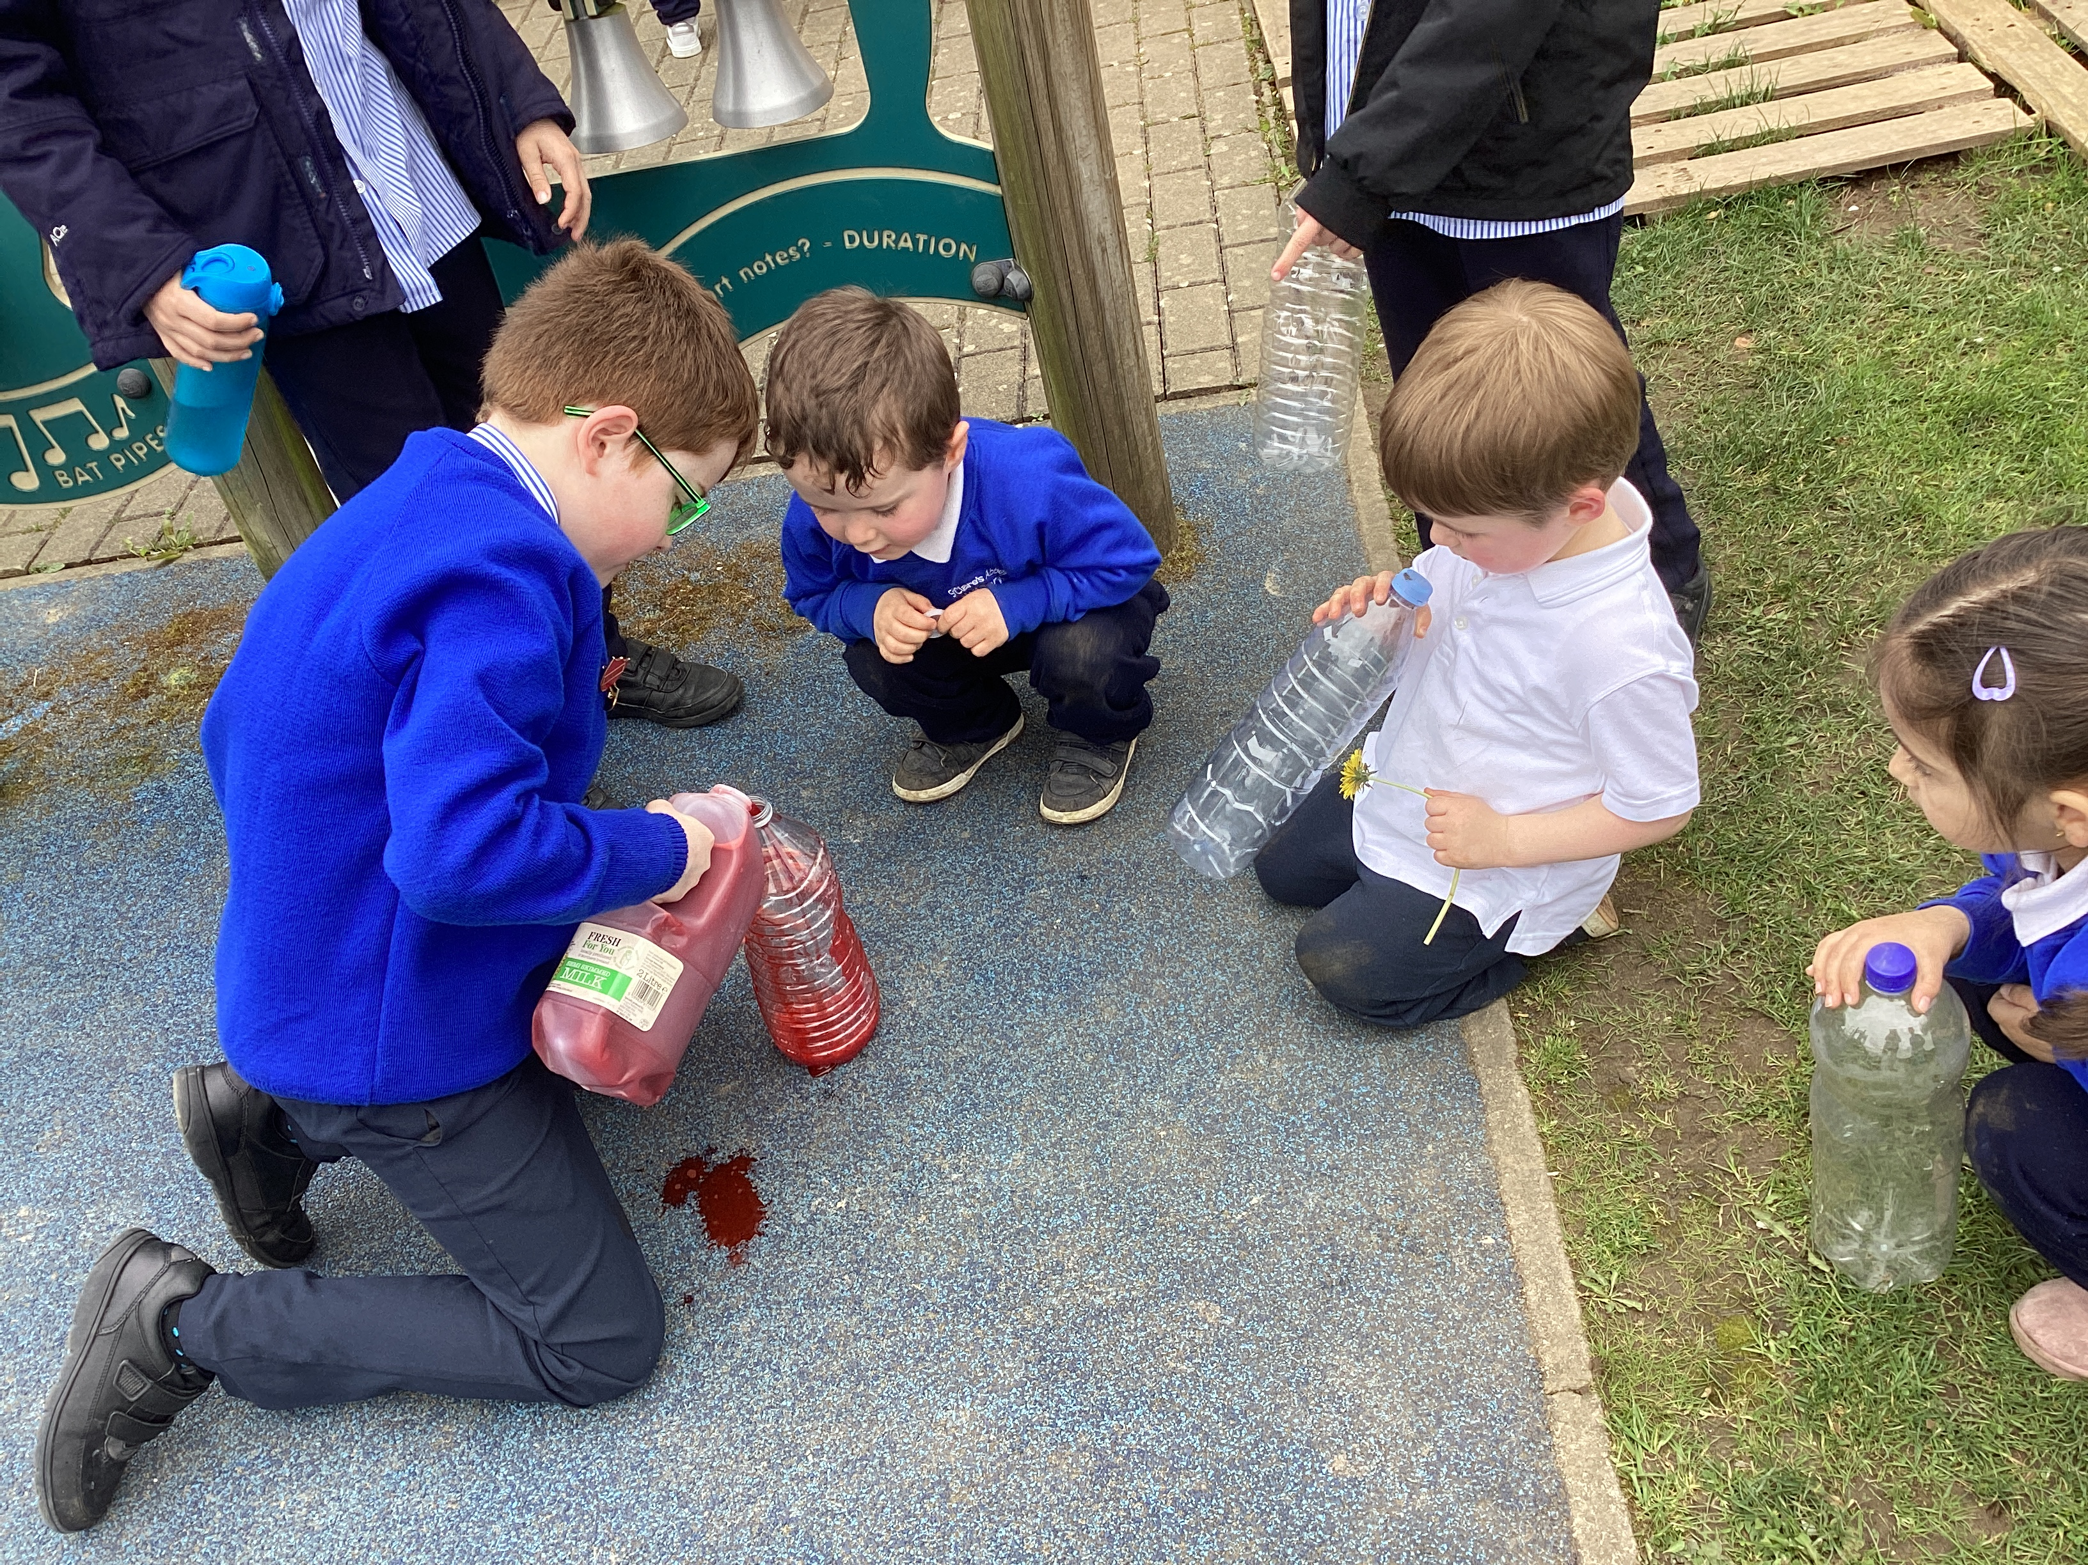
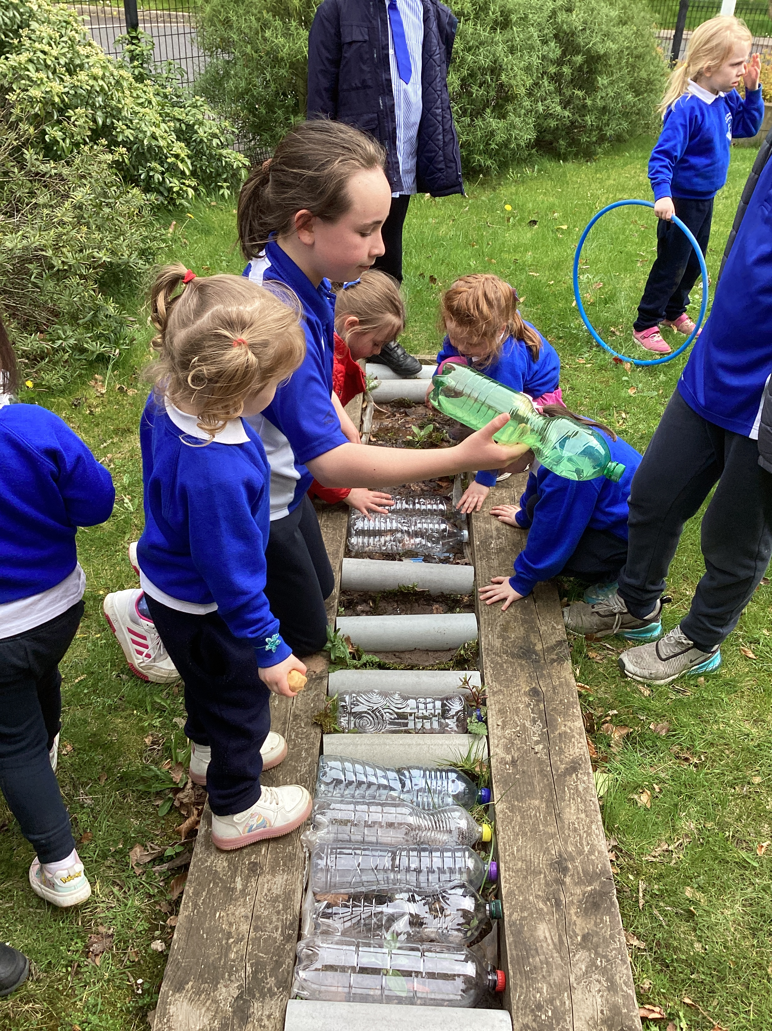
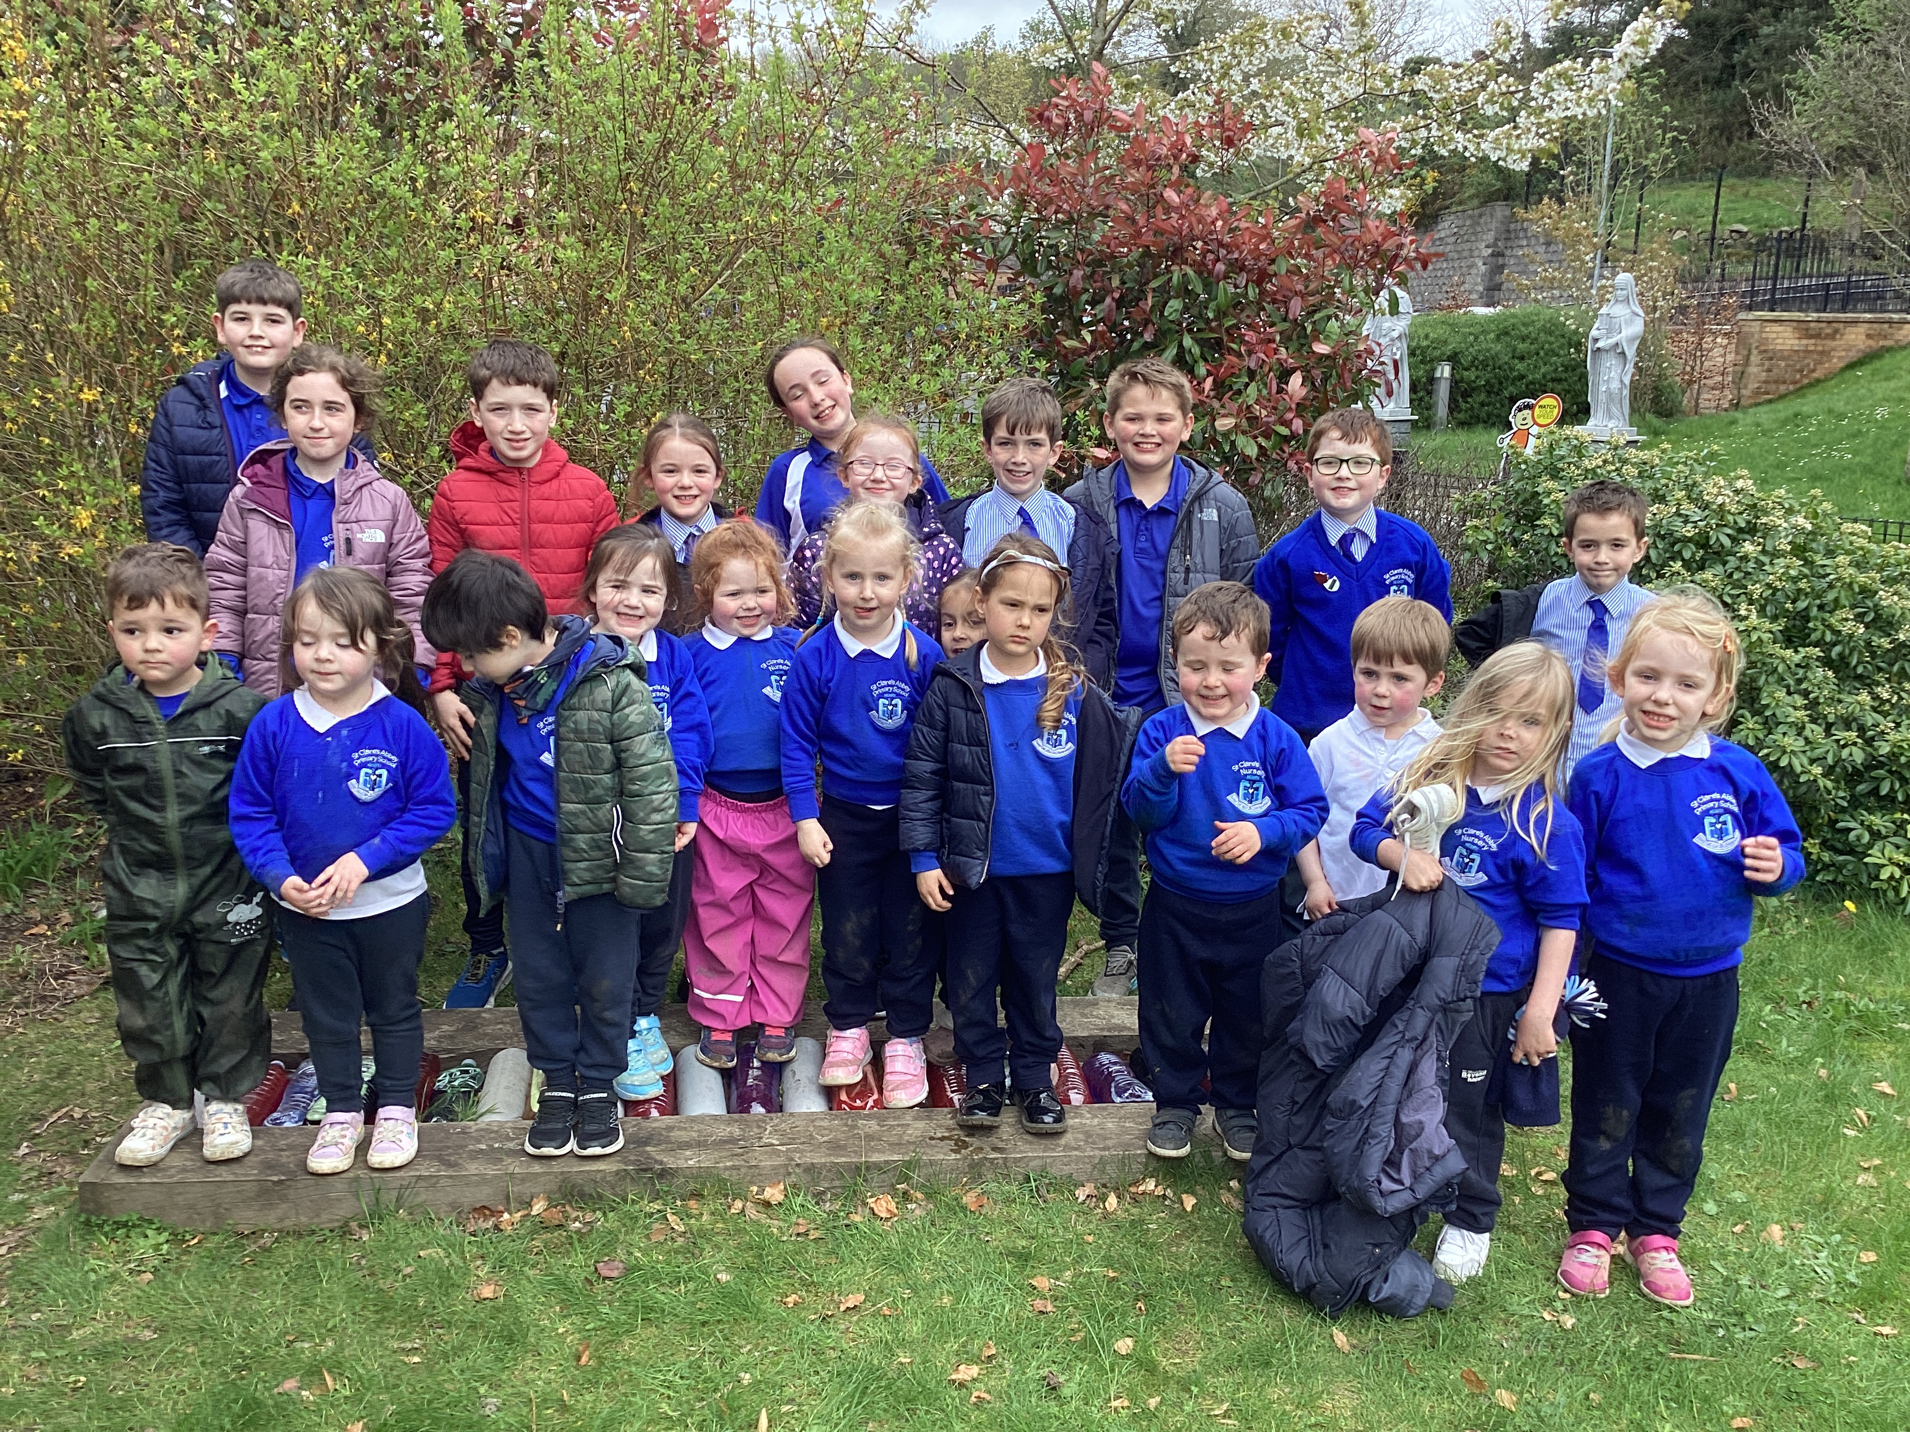
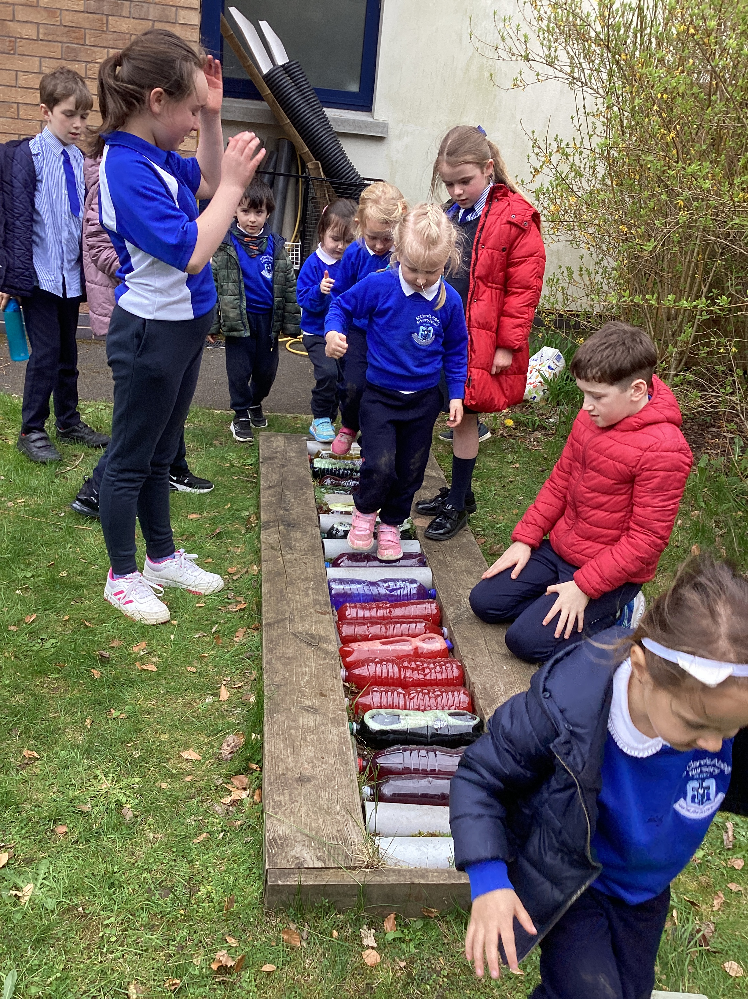
Waste
The nursery have a sensory walk that needed replaced.
We gathered bottles to be recycled and worked with the children to add food dye and create their sensory walk.
We organised the Cash for Clobber campaign for the whole school. We made posters and told families by posting a flyer on the school website. We collected the bags each morning and gathered over 300kg of unwanted clothes to be recycled.
We recycle batteries and ink cartridges in school too.
We are using the money to buy a green plant for each class.

Slide 6
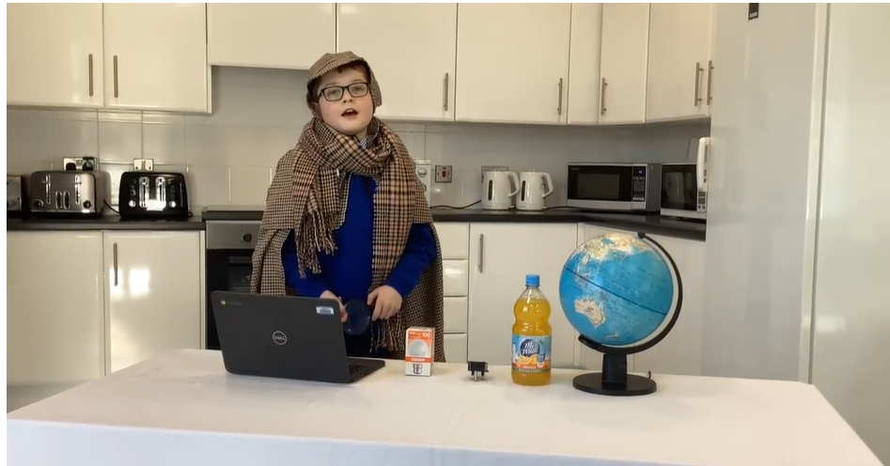
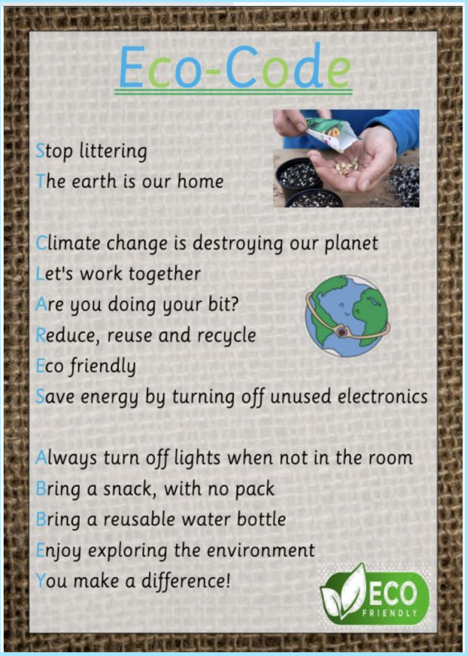
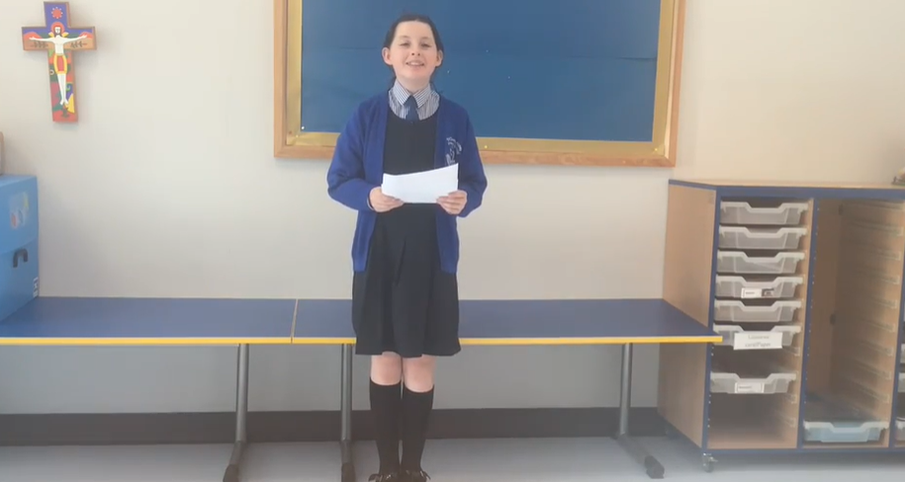
Environmental Youth Speak
2024
I’m an Energy Detective and I’ve been busy investigating how to save energy and this is what I’ve found…
We save energy in school by – turning off the lights, making sure computers and whiteboards are turned off properly.
We have solar panels in school to generate renewable electricity.
We made a new Eco-code this year. These tips for saving energy are all included and it is in every classroom.
2023
Marine Pollution

Slide 7
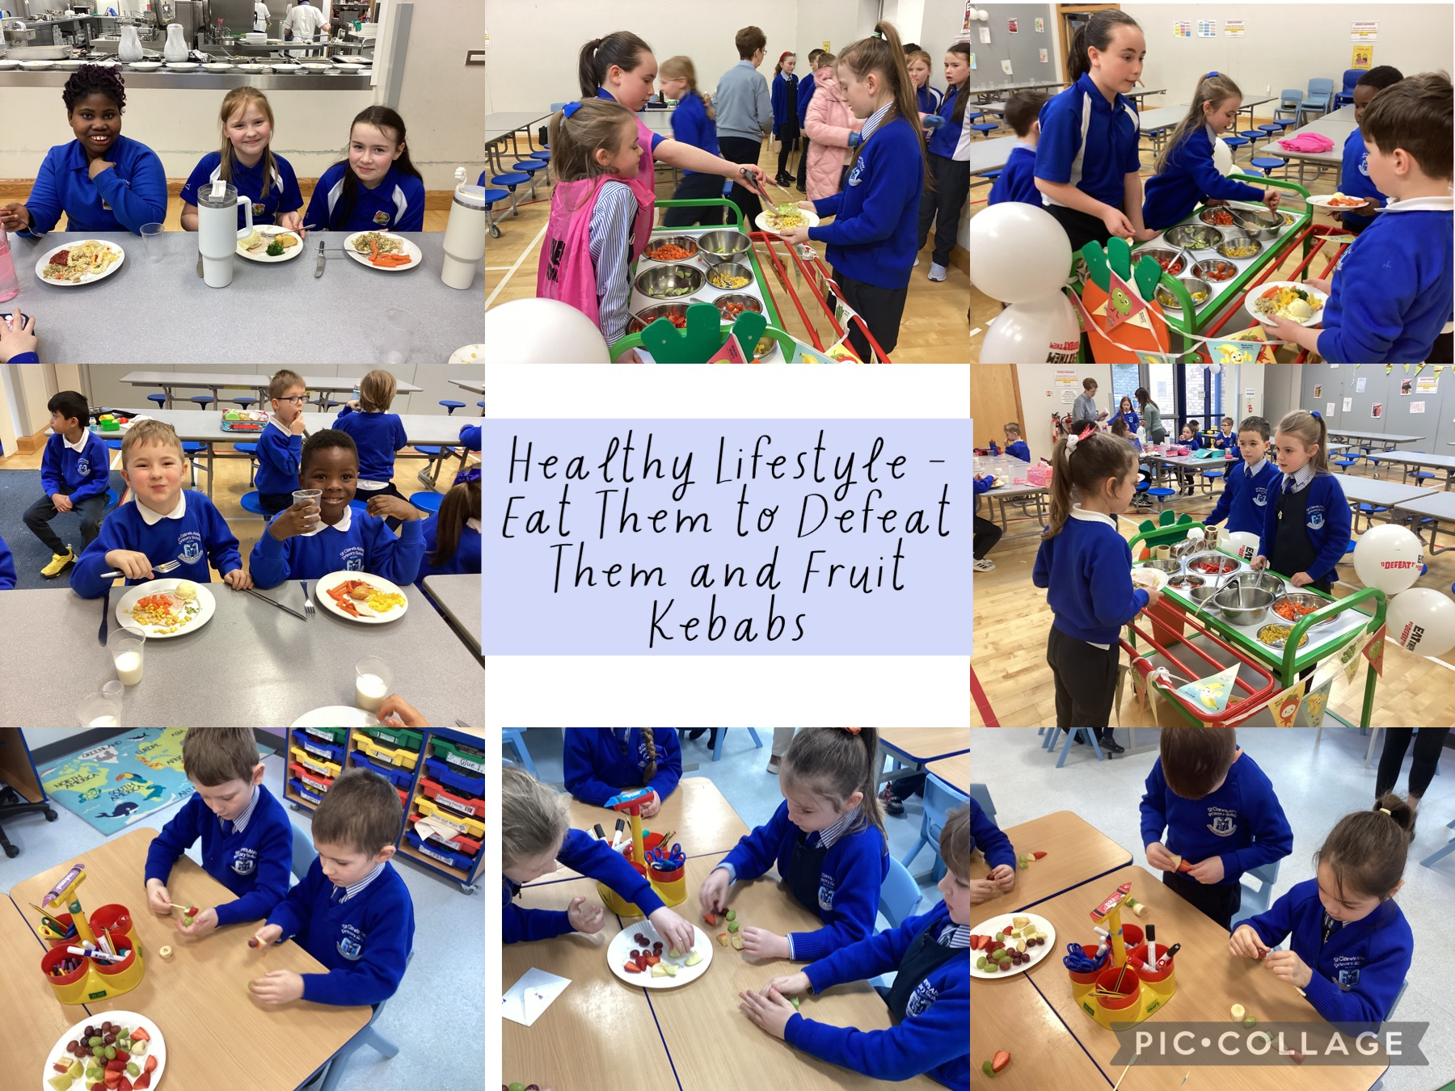
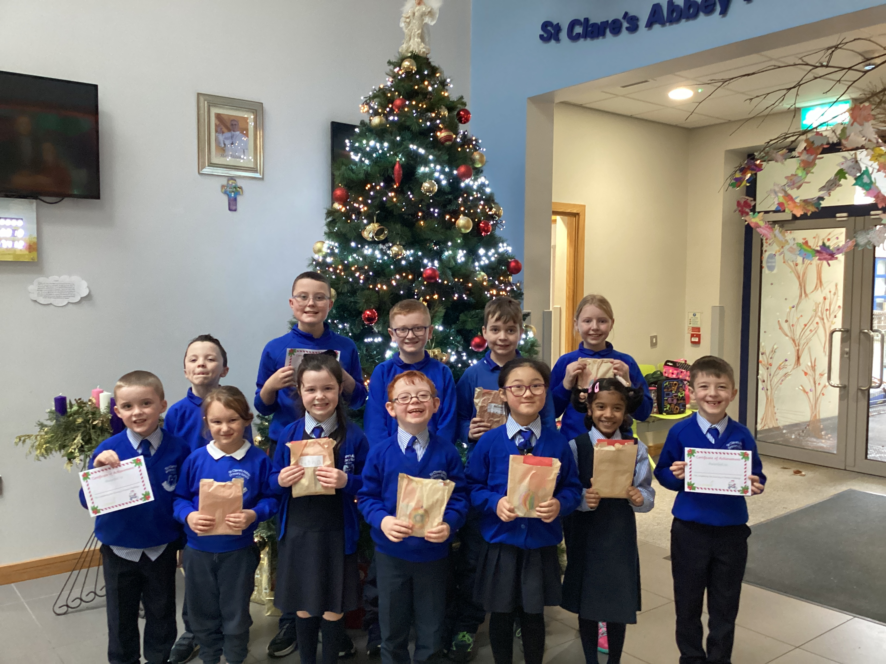
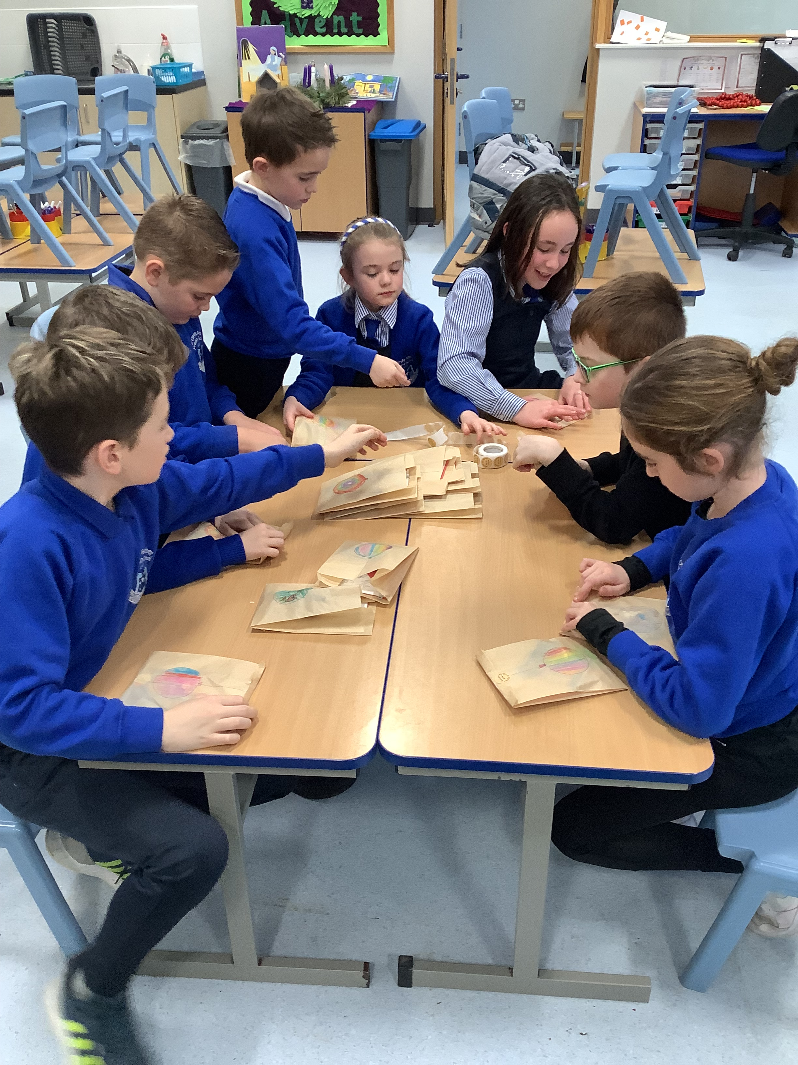
Healthy Living
We organised a campaign called Eat them to Defeat them to encourage children to eat more vegetables. We served vegetables and salad at the salad bar and gave out stickers to the children who tried new vegetables.
Children brought home reward charts to try more vegetables at home too.
In our classes we learn about being healthy. The P2 children made fruit kebabs and always have lots of FAIRTRADE fruit and vegetables for snack.
Transport
As part of our Active Travel Journey to Santa campaign we wanted to choose a winner from each class to get a special prize for completing their 10 journeys.
We decided to create “Eco friendly” prizes that included a pencil made from recycled newspaper, a rubber made from recycled materials and a reflector keychain, wrapped in a recycled and recyclable brown bag.

